Slide 1
GPS NAVIGATION DATA ANALYSIS
Presenter: Muhammad Adeen Tariq
(Research Officer)
Major Contributor: Murad Abdullah
(U/G Researcher)
Principal Investigator: Dr. Tariq Mairaj Rasool Khan

Slide 2
REASONS OF PERFORMING DATA ANALYSIS
To find out which 5 satellites (defined in configuration file) are visible at particular times of the day
The rotation pattern of satellite in its orbit during the time of visibility
When will the same 5 satellites be visible next time , i.e , is this process cyclic ? If so, then what is the interval of this cycle. This will require data logging for a day or two
To deeply investigate the following statement:
every two hours, the data in subframes 1, 2 and 3, the ephemeris and clock's
parameters, are updated (source: https://www.e-education.psu.edu/geog862/node/1735)
To undertand which parameters play a role in change of computed GPS receiver position when data is logged at the same time by different receivers placed few meters apart

Slide 3
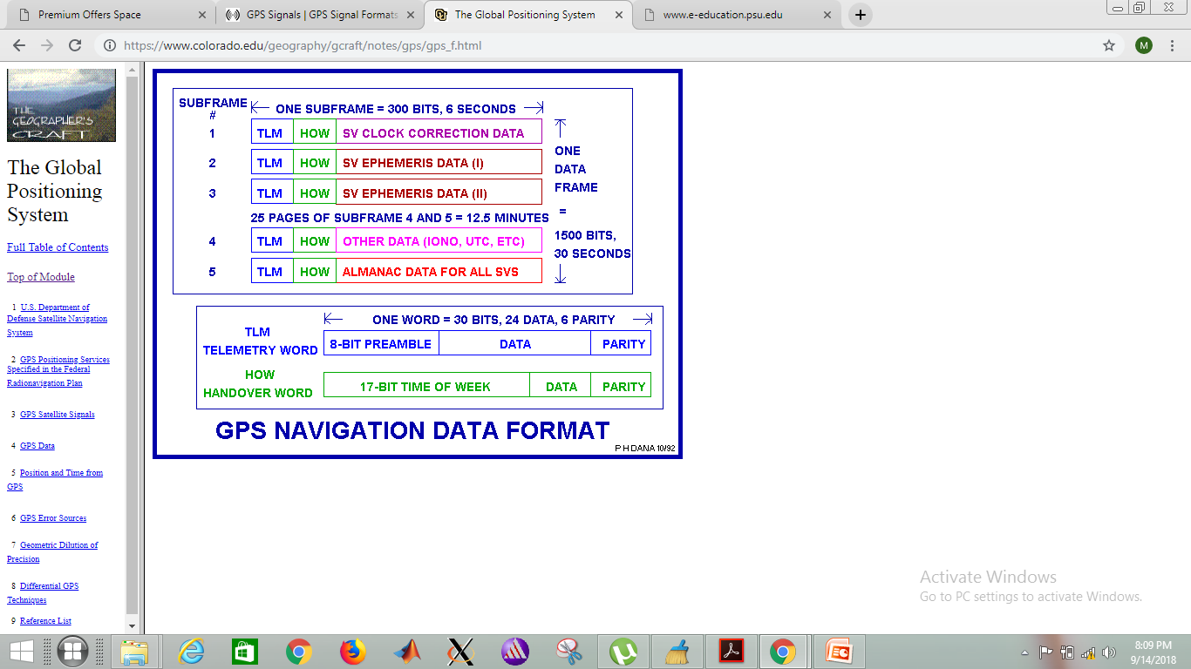
TYPES OF DATA LOGGING PERFORMED
We have performed two types of data logging on GNSS-SDR software:
Dumping of computed x, y ,z co-ordinates (in ECEF) of all visible satellites and the pseudo ranges of these satellites from the GPS receiver
Dumping of raw navigation message bits of all the visible satellites

Slide 4
DATA LOGGING HIERARCHY OF NAV DATA
Satellite Subframe Files
Sat PRN 1
Sat PRN 2
Sat PRN 3
Sat PRN 32
…….
…….
…….
…….
Subframe No.1
Subframe No.2
Subframe No.3
Subframe No.4
Subframe No.5
Subframe 1
Instances
Subframe 2 Instances
Subframe 5 Instances
…….
…….

Slide 5
Visible Satellites
Sat PRN 1
Sat PRN 2
Sat PRN 3
Sat PRN 32
…….
…….
…….
Subframe No.1
Subframe No.2
Subframe
No.3
Clock Correction
Parameters :
gps_week, ca_or_p_on_l2, sv_accuracy, sv_health, t_gd, iodc, af2,af1,afo
Ephemeris Part 1
Parameters :
sqrt_A,delta_n, Toe, Mo,e ,w,C_us, C_uc, C_rs, iode_sf2,Aodo
Ephemeris Part 2
Parameters :
C_is,C_ic, i_o, idot,omega ,omega_o,omegadot,C_rc,iode_sf3
Common Parameter: Tow

Slide 6
MAJOR FINDINGS
Data logging has been performed for approximately 7 hours
Data logging must be monitored frequently, to avoid large sets of “loss of locks” and to prevent data from being messy
GNSS-SDR software runs for a max of 3 hours and then stops automatically, so it should be restarted accordingly
Following is the set of visible satellites:
1, 3, 7, 8, 9, 11, 13, 16, 17, 18, 22, 23, 27, 30
The plot which shows the time in seconds for which a particular satellite is visible is given in the next slide

Slide 7
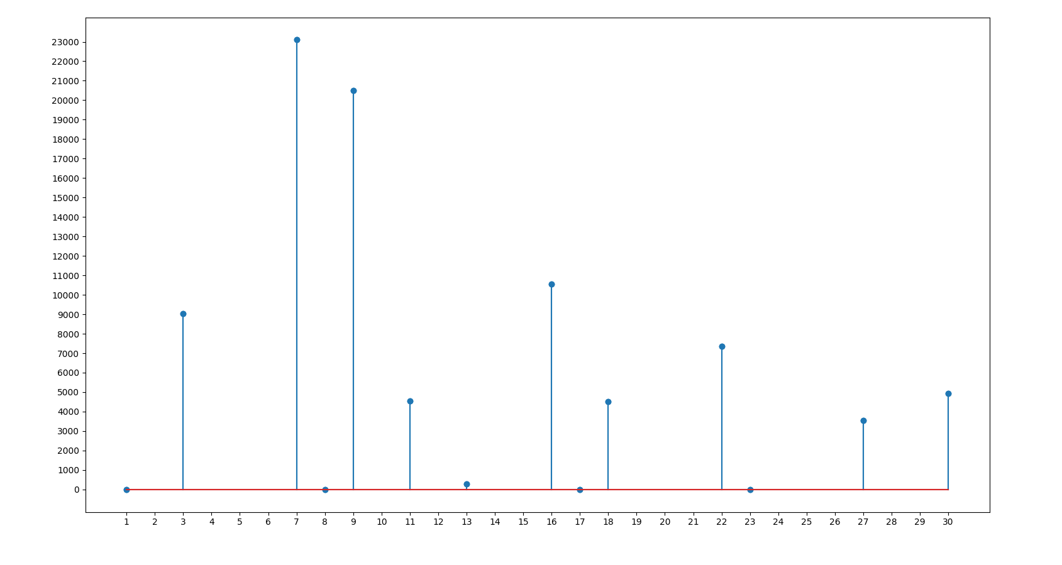
S
E
C
O
N
D
S
SATELLITE NO.

Slide 8
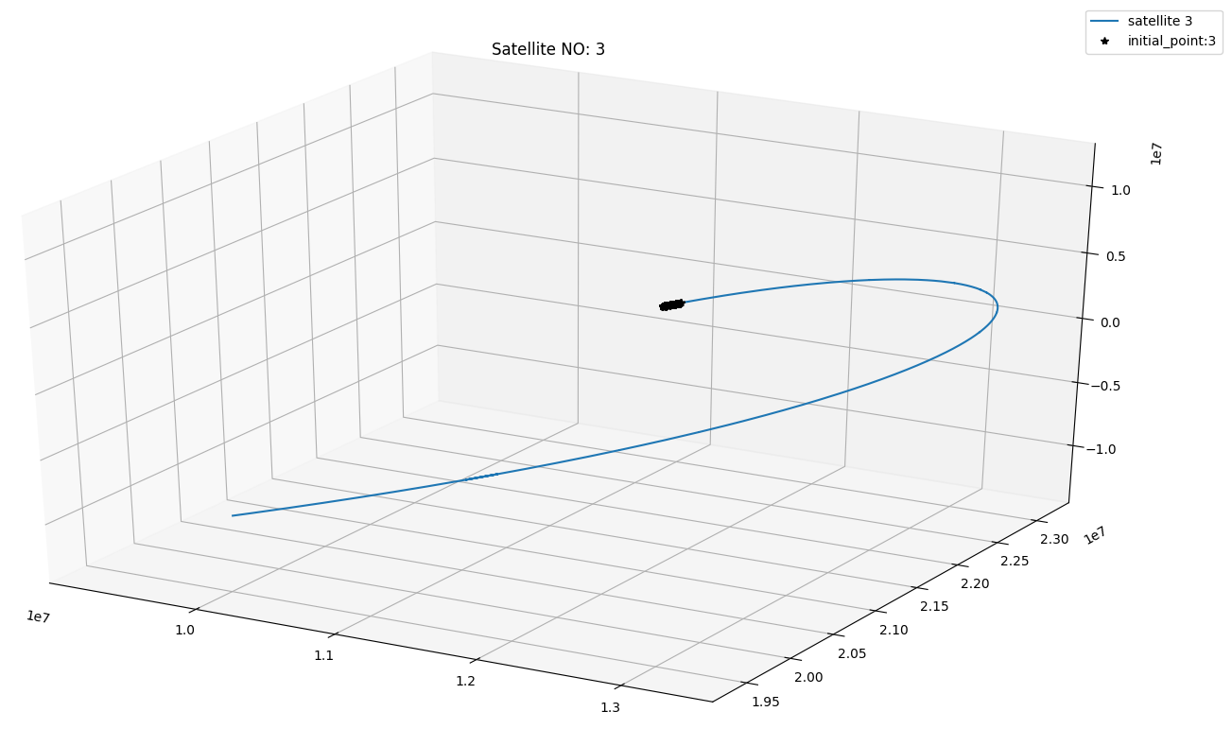
SATELLITE ORBITAL PATH
By plotting the satellite x,y,z co-ordinates (in ECEF) for a longer duration, we can determine the orbital path of visible satellites partially
A satellite is visible for a certain interval of time to a specific location on earth , so due to this fact , we can’t plot the whole orbit of a satellite by logging data at a static location
There are 6 orbital planes and each orbit contains 4 satellites
If there are discontinuities in data logging , then the plotted path of some satellites won’t provide conclusive results

Slide 9
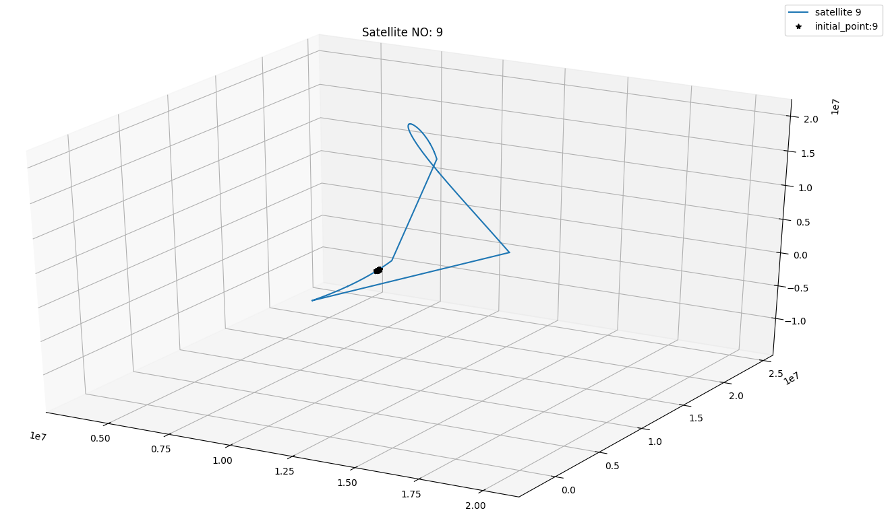
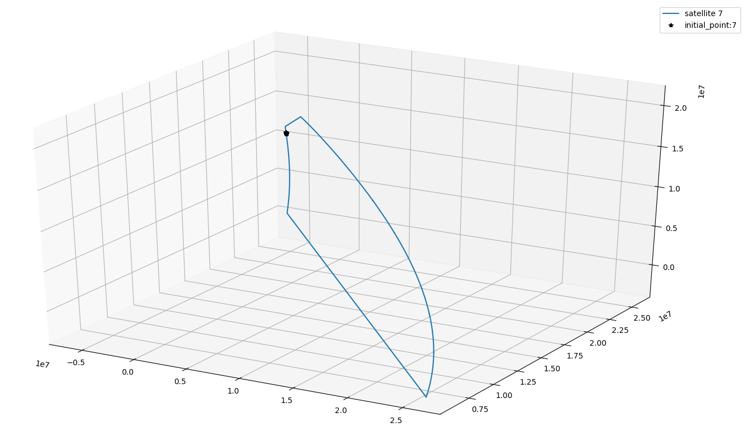
These sort of oribtal patterns are apparently due to discontinuity in data stream

Slide 10
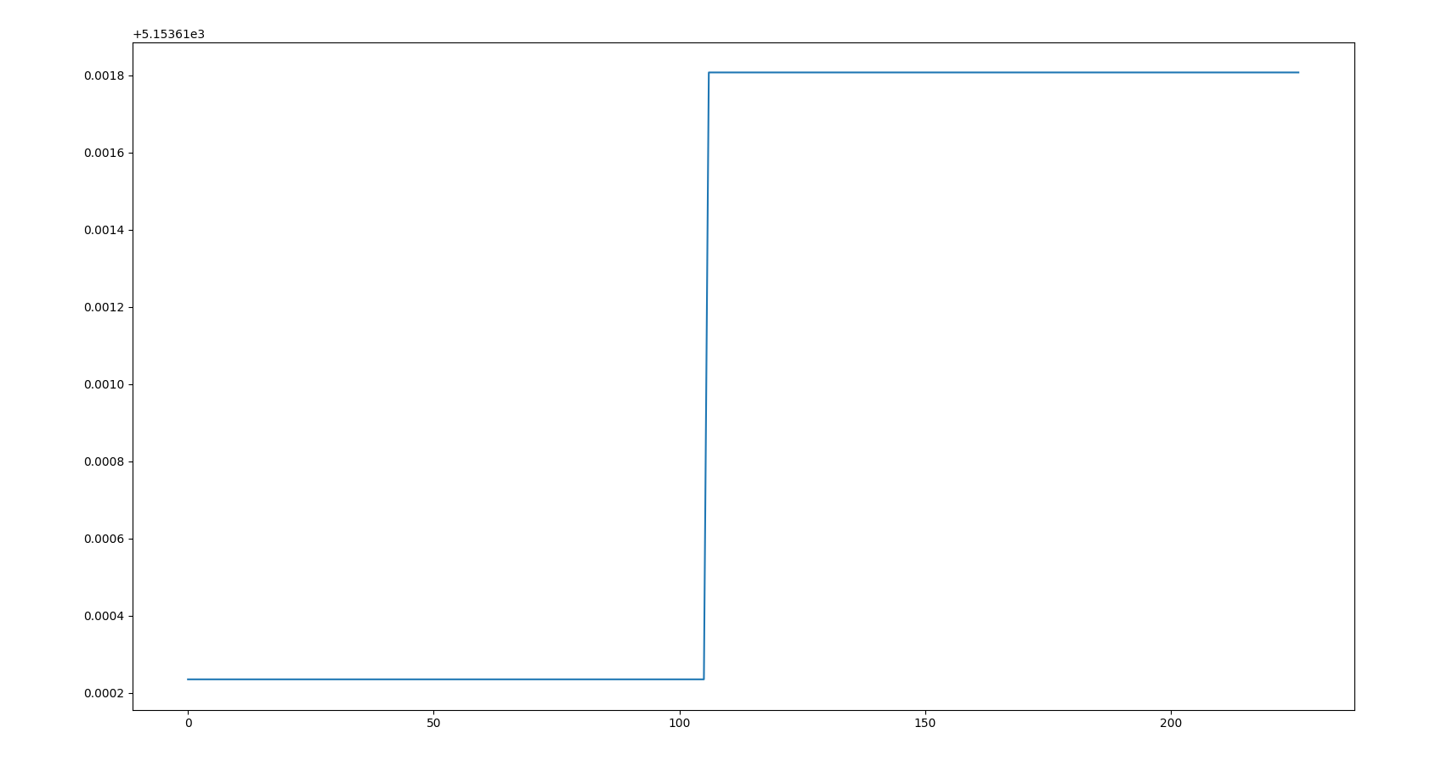
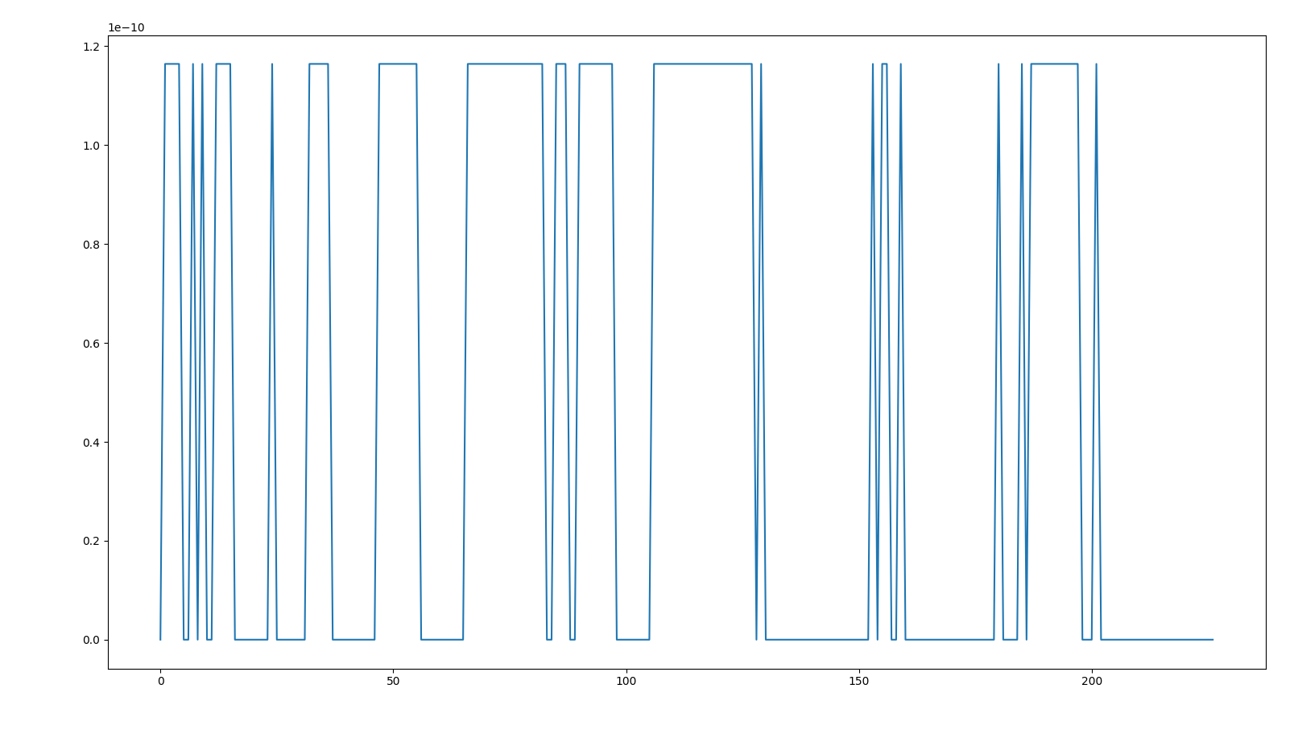
EPHEMERIS PARAMETERS
The following ephemeris parameters are part of subframe 2 of satellite no.3
Some ephemeris parameters change more frequently and some change less frequently
There are a total of 16 ephemeris parameters which contribute in finding satellite position
Sqrt
A
e

Slide 11
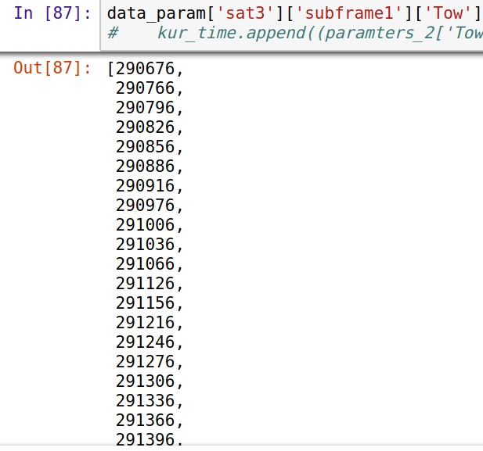
TIME OF WEEK
Time of Week of satellite 3 , subframe 1 is given below. We can clearly see that there is a difference of 30 seconds or a difference of multiple of 30 between values bacause each value belongs to a different frame

Slide 12
FUTURE APPROACHES
Completion of code
Log new sets of data, with frequent monitoring, so that we don’t get discontinuities and garbage values
To undertand which parameters play a role in change of computed GPS receiver position when data is logged at the same time by different receivers placed few meters apart
Perform data Analysis on new sets of data
Compare results from different GPS receivers obtained as a result of simultaneous data logging

